Slide 1
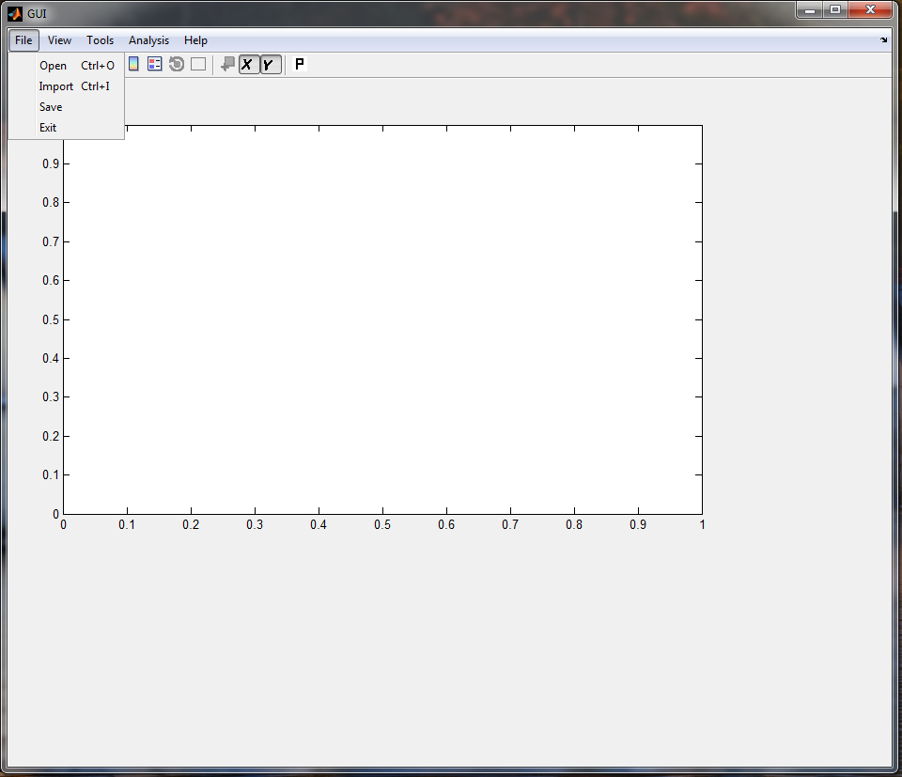
GUI Demo
Click Open to open the available “.mat”.
If data is available in Excel format, click on import. The data will be imported and saved as “.mat” file for future use. In the same directory
Open or Import Database
Click on Open

Slide 2
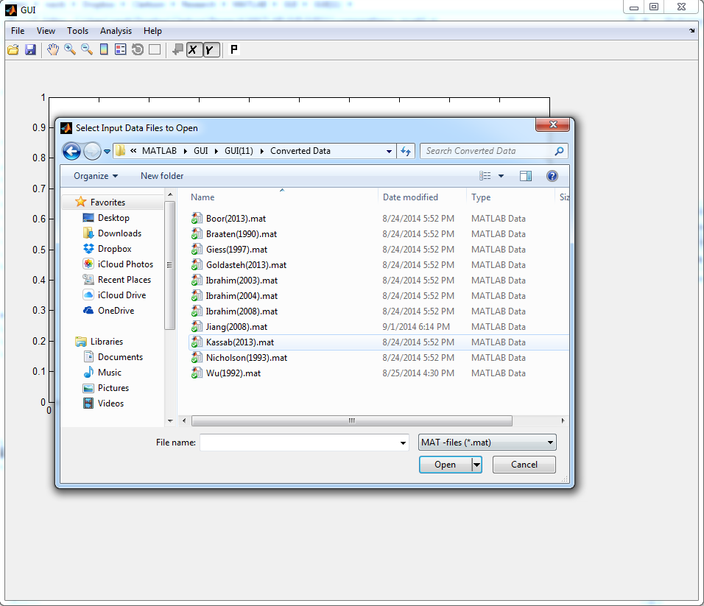
1
Select the database files
2

Slide 3
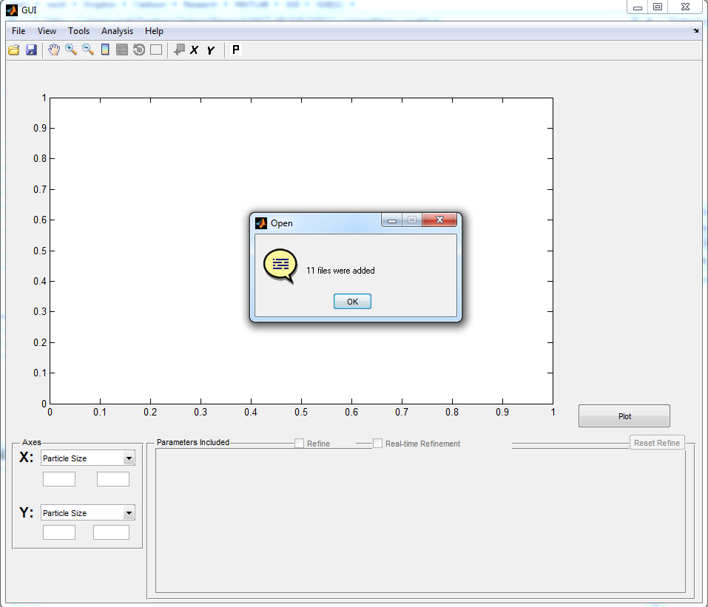

Slide 4
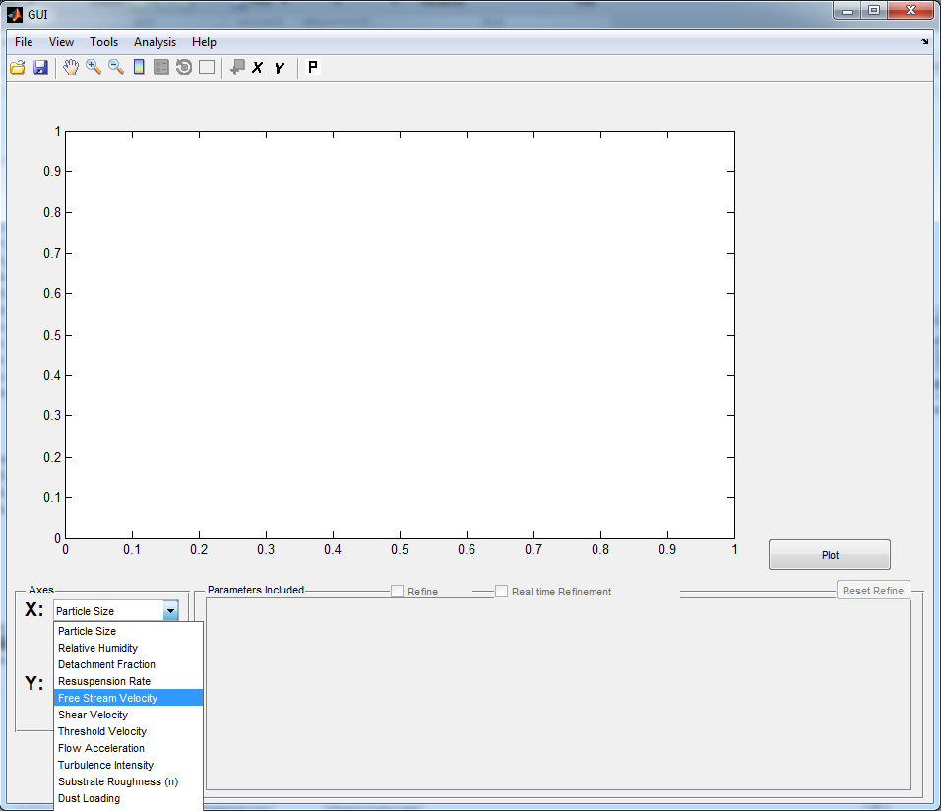

Slide 5
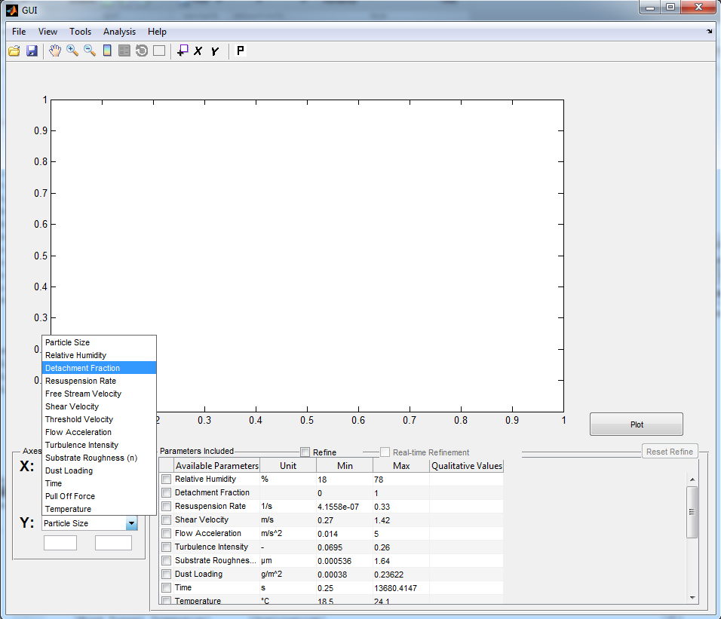
The Quantitative parameters could be selected as X or Y axis.
Then the other parameters are listed in the table with corresponding ranges or list of values.
At least one parameter needs to be selected as legend from table for plotting the data.

Slide 6
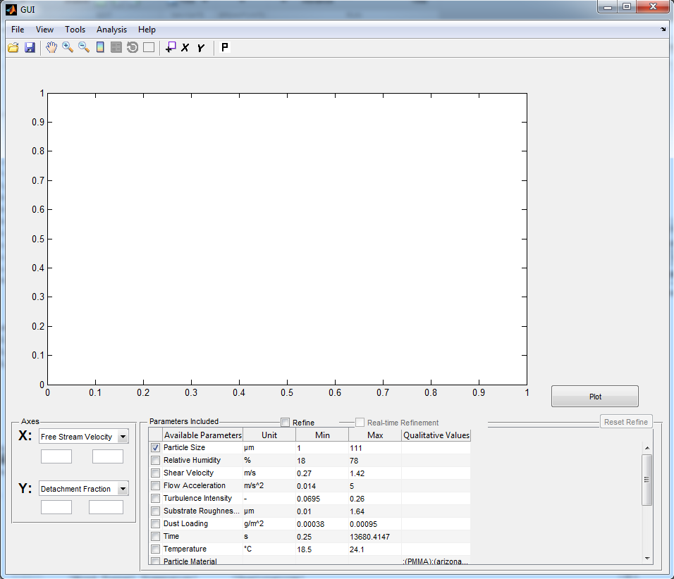
2
1
Select parameter
At least one and at most three(two Quantitative & one Qualitative)

Slide 7
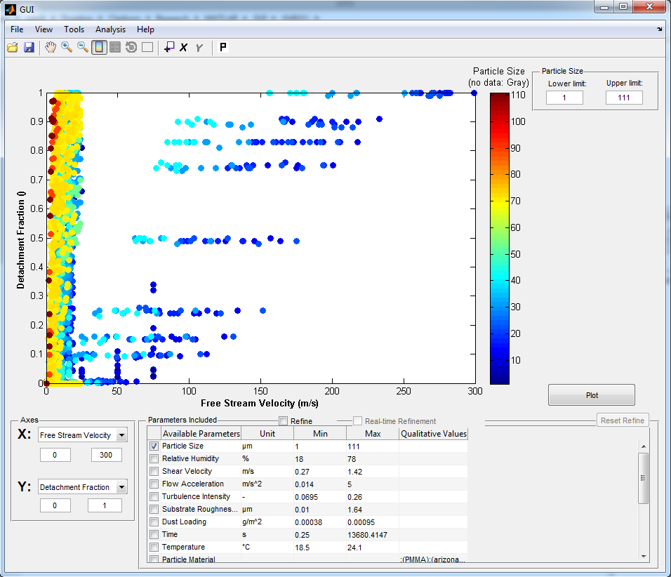
Change the x axis range

Slide 8
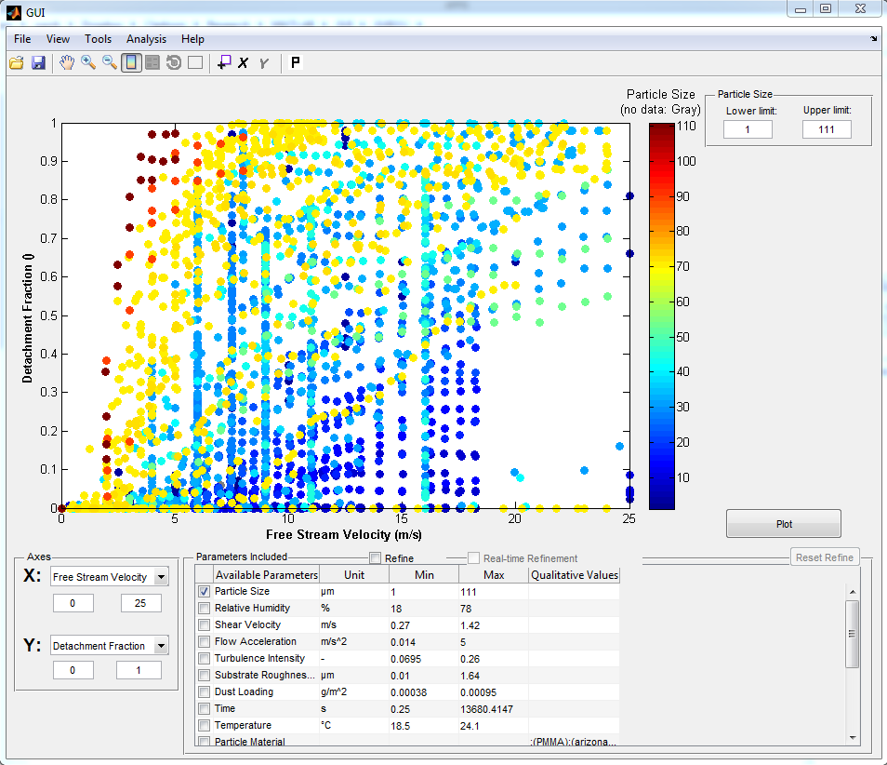

Slide 9
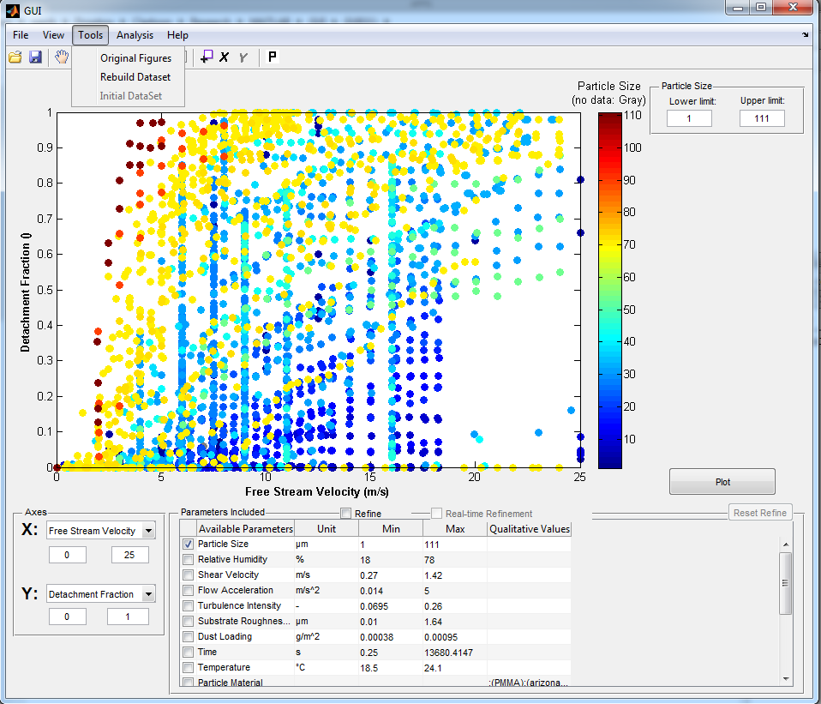
Rebuild the data by choosing the “Max”, “Min” or “Mean” value of the specified parameter in each dataset.
For example Rebuild the dataset to show only data corresponded to maximum time for particle resuspension data that are available as function of time.

Slide 10
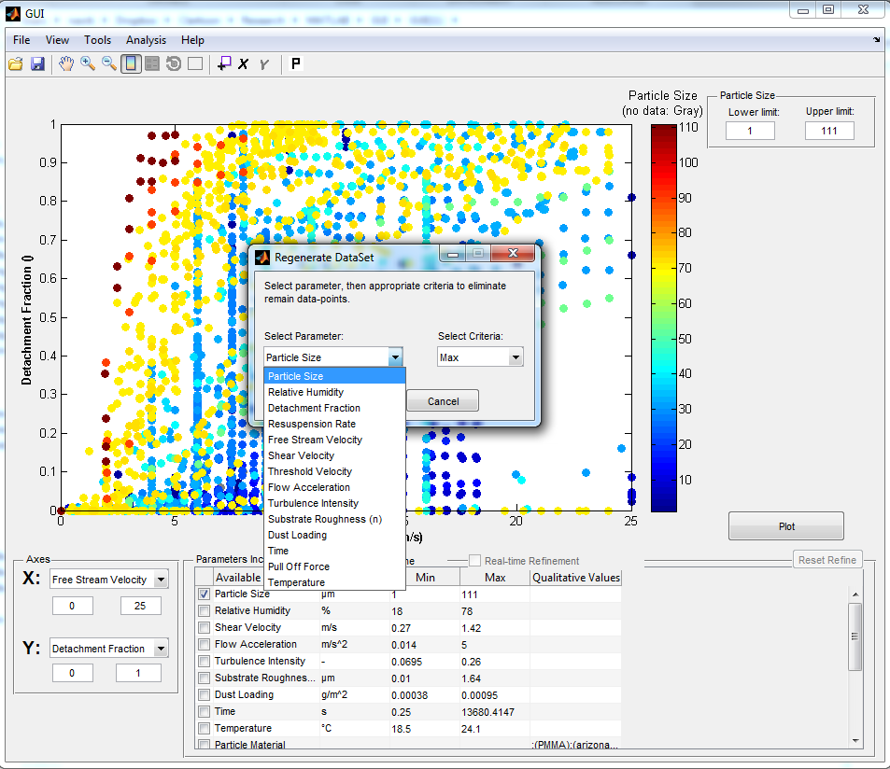

Slide 11
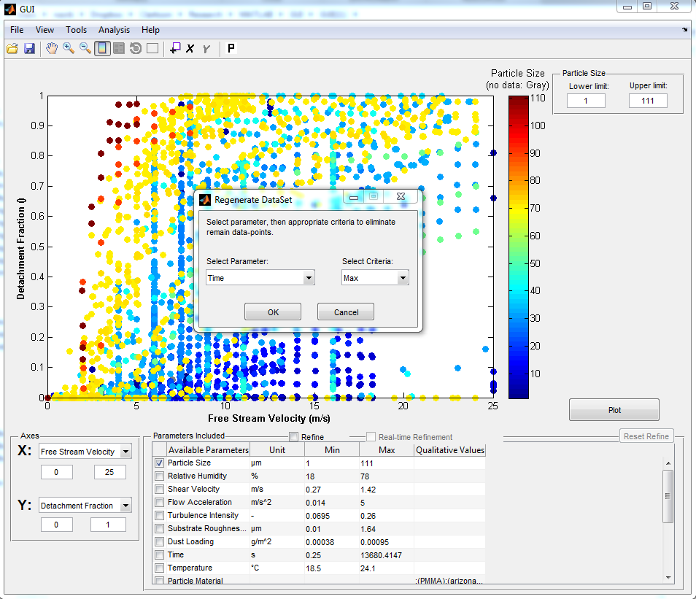

Slide 12
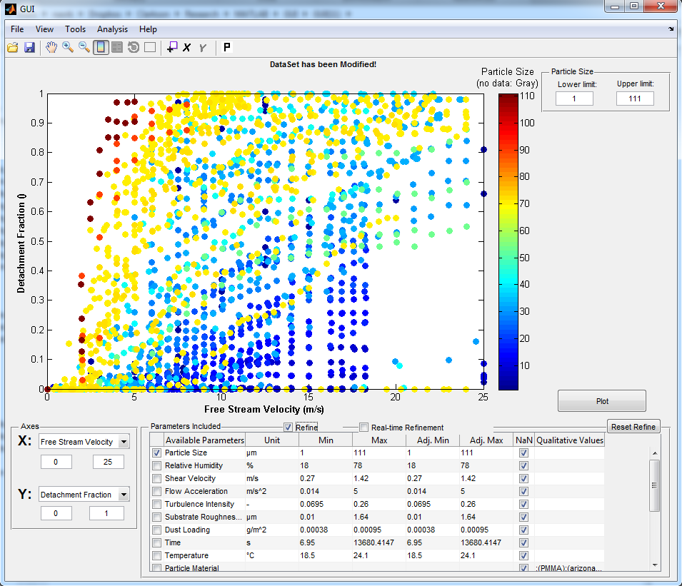
Select Refine
Ability to Refine Database

Slide 13
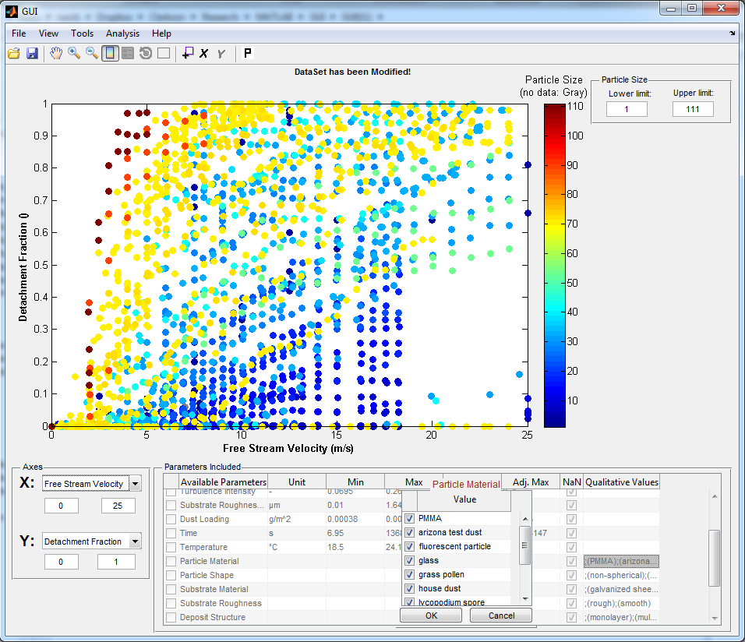
Select the Value for Qualitative Parameters
Example:
Particle Material-> Glass & Soda lime Glass
2
1
3

Slide 14
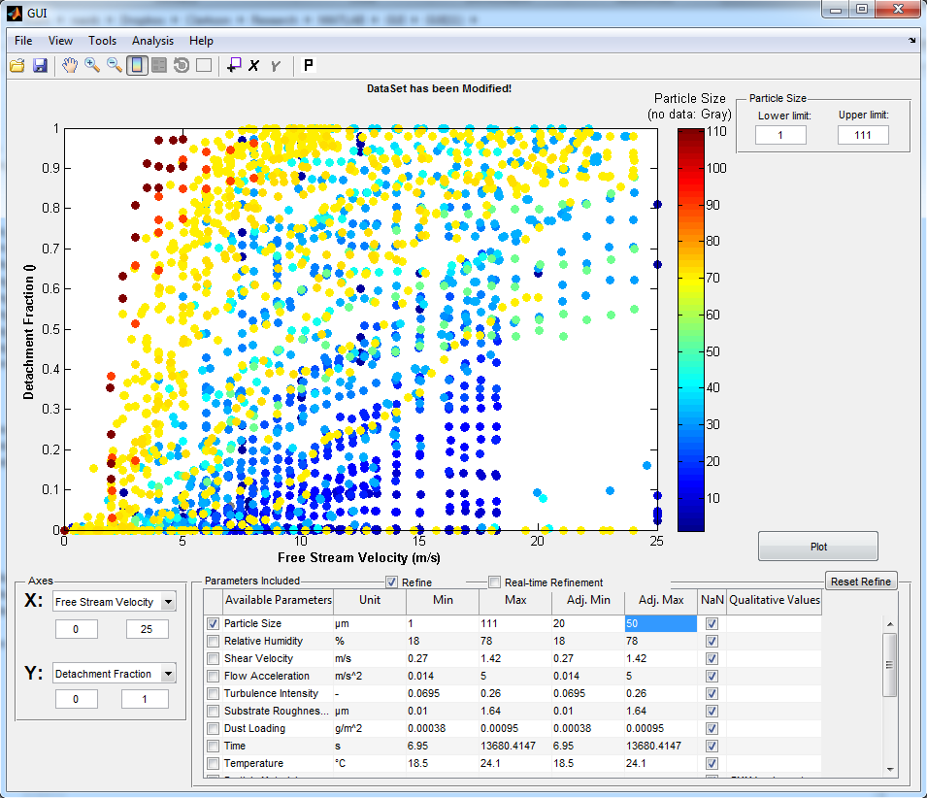
2
1
Ability to adjust Quantitative Parameter range
Example:
Particle size range set to 20 to 50 µm

Slide 15
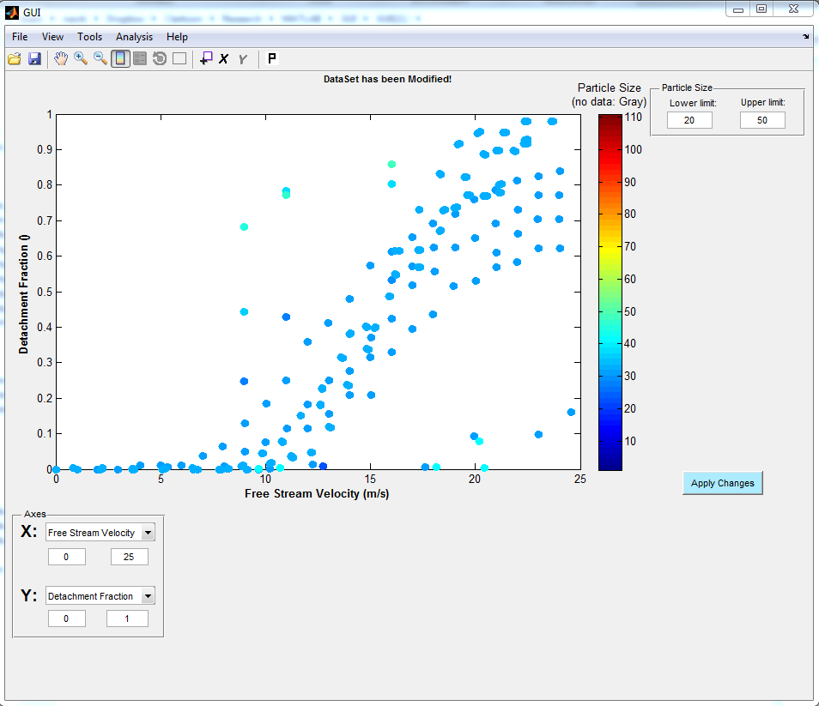
1
Ability to Adjust Legends
2

Slide 16
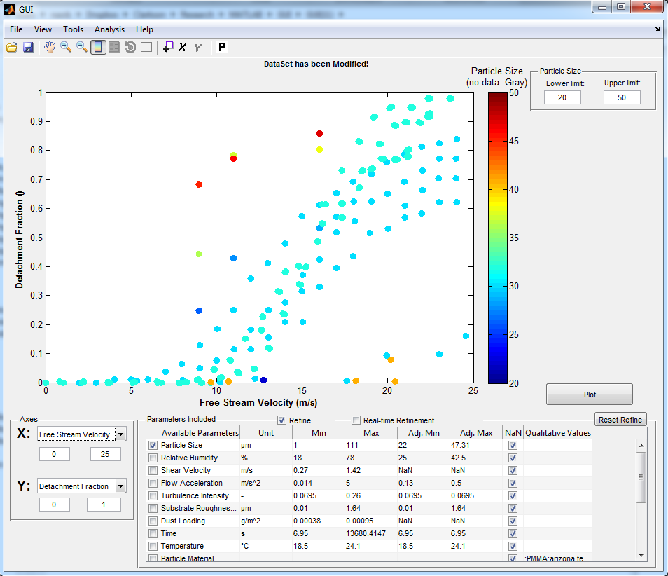

Slide 17
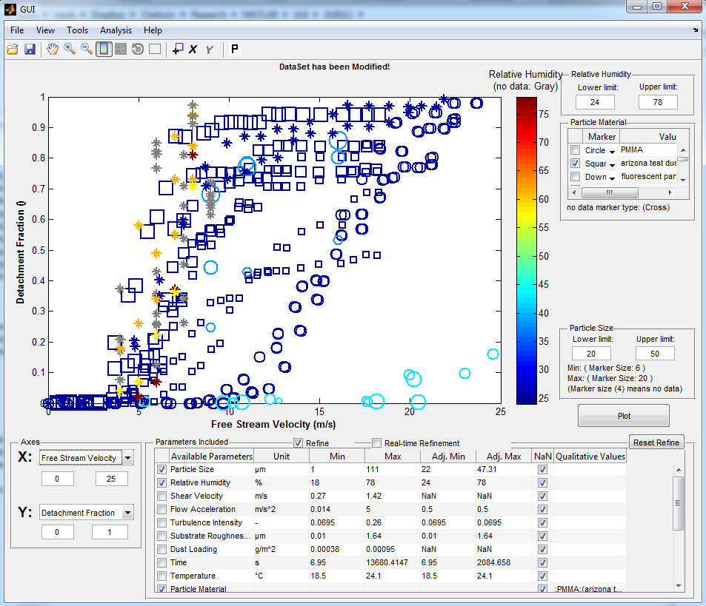
Example:
Refine Data set to:
Particle Material:
- Glass
ATD
Lycopodium Spore
Particle Size Range:
20 to 50 µm
Legends are:
Particle Size as Marker Size
RH as Color
Particle Material Marker Type

